Slide 1
Generation of Typical Digital Signals and Its Frequency Spectrum Analysis by Using MATLAB
Fundamentals and Experiments

Slide 2
Content
Generate Typical Signals in MATLAB;
Import an Audio File to MATLAB Workspace;
Analyze Signals by Using DTFT/DFT in MATLAB;
Experiment Tasks and Goals;

Slide 3
Generate Typical Signals
1.

Slide 4
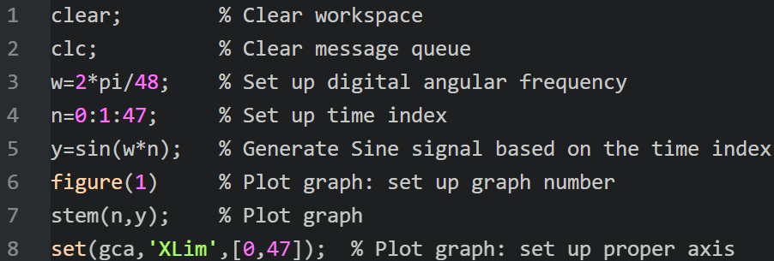
Generate Typical Signals in MATLAB
1.
Generate a SINE signal which angular frequency $ω=\frac{2π}{48}$

Slide 5
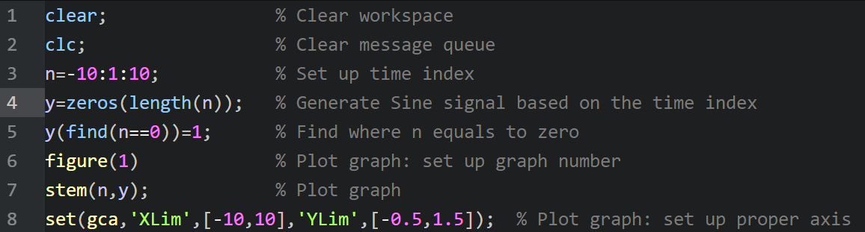
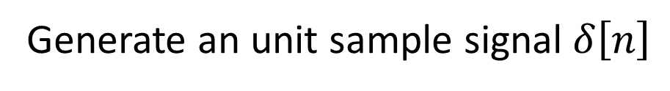
Generate Typical Signals in MATLAB
1.
Generate an unit sample signal $δ\left[n\right]$

Slide 6
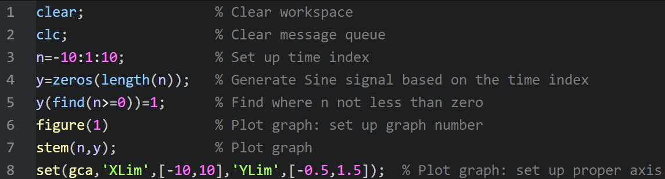
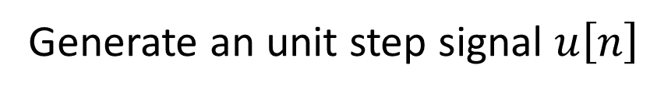
Generate Typical Signals in MATLAB
1.
Generate an unit step signal $u\left[n\right]$

Slide 7
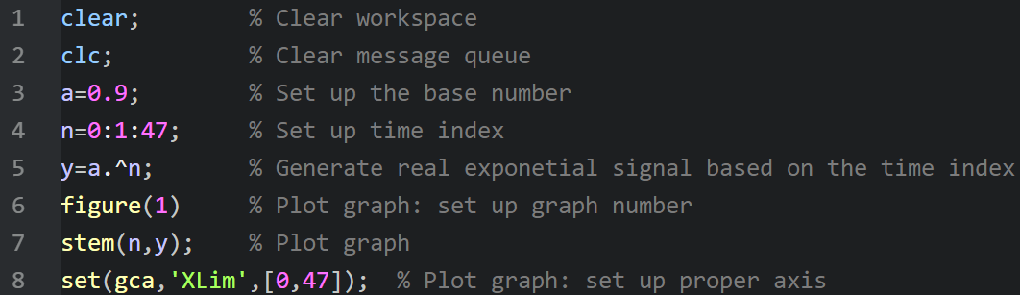
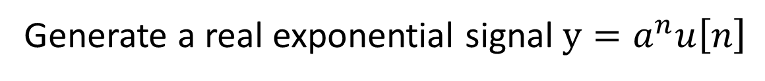
Generate Typical Signals in MATLAB
1.
Generate a real exponential signal $y=a^{n}u\left[n\right]$

Slide 8
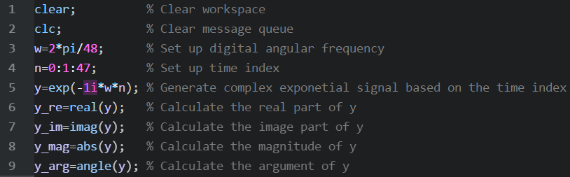
Generate Typical Signals in MATLAB
1.
Generate a complex exponential signal $y=e^{jωn}u\left[n\right]$, where $ω=\frac{2π}{48}$

Slide 9
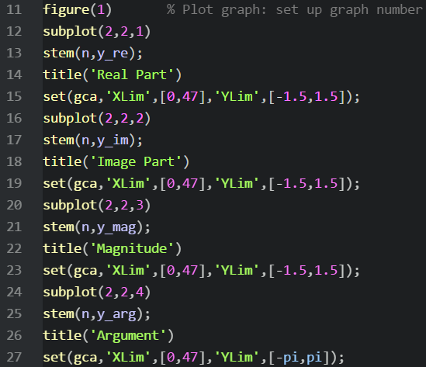
Generate Typical Signals in MATLAB
1.
Generate a complex exponential signal $y=e^{jωn}u\left[n\right]$, where $ω=\frac{2π}{48}$

Slide 10
Input an Audio File to Workspace
2.

Slide 11
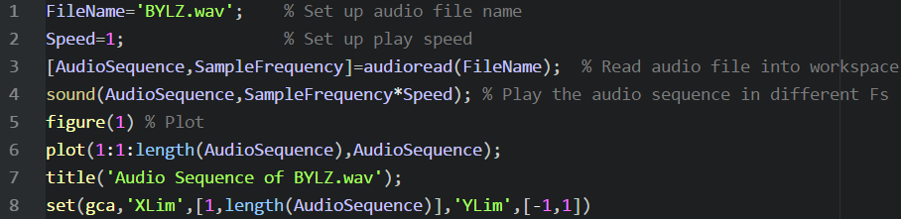
Import an Audio File to MATLAB Workspace
2.

Slide 12
Import an Audio File to MATLAB Workspace
2.

Slide 13
Analyze Signals by Using DTFT/DFT
3.

Slide 14
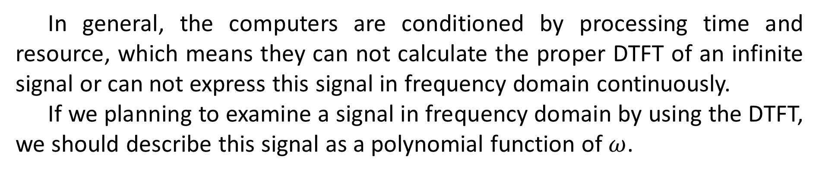
Analyze Signals by Using DTFT/DFT in MATLAB
3.
In general, the computers are conditioned by processing time and resource, which means they can not calculate the proper DTFT of an infinite signal or can not express this signal in frequency domain continuously.
If we planning to examine a signal in frequency domain by using the DTFT, we should describe this signal as a polynomial function of $ω$.

Slide 15
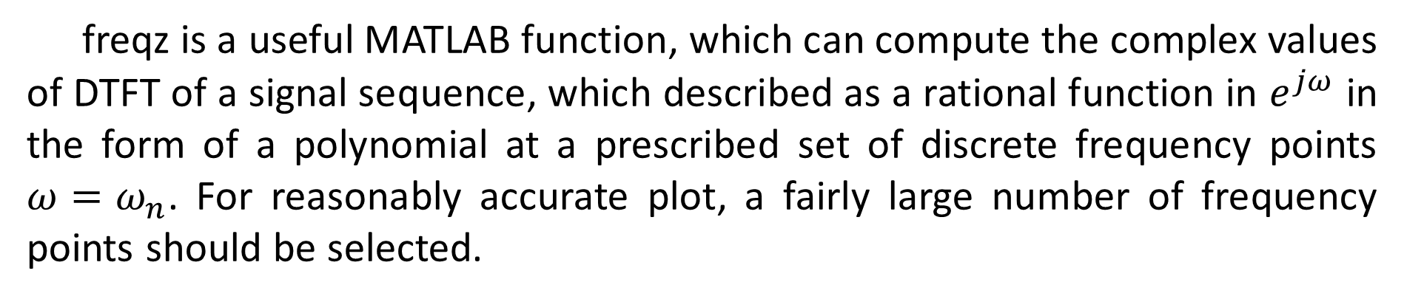
Analyze Signals by Using DTFT/DFT in MATLAB
3.
freqz is a useful MATLAB function, which can compute the complex values of DTFT of a signal sequence, which described as a rational function in $e^{jω}$ in the form of a polynomial at a prescribed set of discrete frequency points $ω=ω_{n}$. For reasonably accurate plot, a fairly large number of frequency points should be selected.

Slide 16
Analyze Signals by Using DTFT/DFT in MATLAB
3.

Slide 17
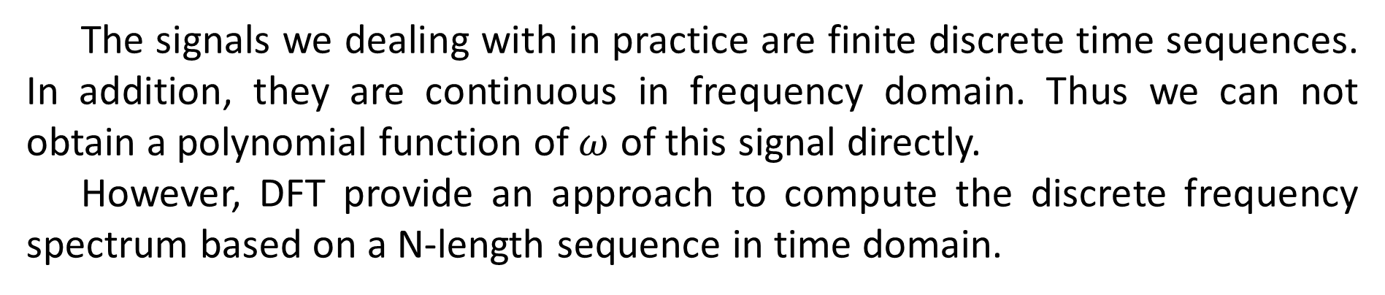
Analyze Signals by Using DTFT/DFT in MATLAB
3.
The signals we dealing with in practice are finite discrete time sequences. In addition, they are continuous in frequency domain. Thus we can not obtain a polynomial function of $ω$ of this signal directly.
However, DFT provide an approach to compute the discrete frequency spectrum based on a N-length sequence in time domain.

Slide 18
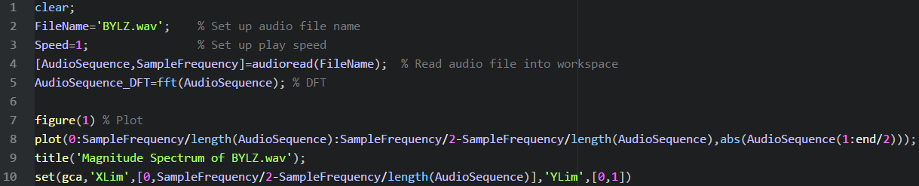
Analyze Signals by Using DTFT/DFT in MATLAB
3.

Slide 19
Experiment Tasks and Goals
4.

Slide 20
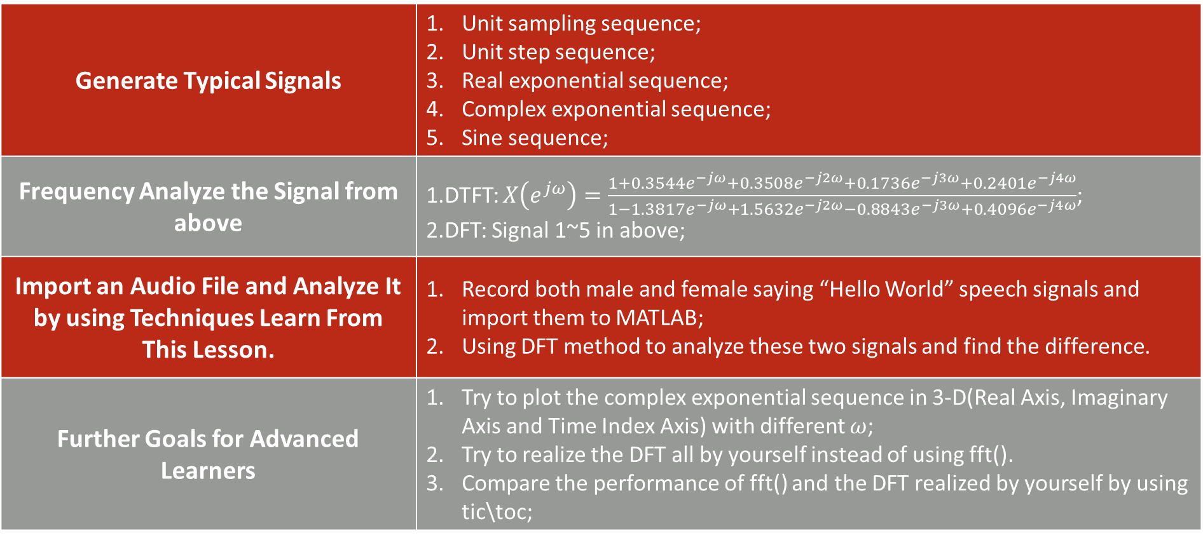
Experiment Tasks and Goals
Generate Typical Signals | Unit sampling sequence; Unit step sequence; Real exponential sequence; Complex exponential sequence; Sine sequence;
Frequency Analyze the Signal from above | 1.DTFT: $X\left(e^{jω}\right)=\frac{1+0.3544e^{−jω}+0.3508e^{−j2ω}+0.1736e^{−j3ω}+0.2401e^{−j4ω}}{1−1.3817e^{−jω}+1.5632e^{−j2ω}−0.8843e^{−j3ω}+0.4096e^{−j4ω}}$; 2.DFT: Signal 1~5 in above;
Import an Audio File and Analyze It by using Techniques Learn From This Lesson. | Record both male and female saying “Hello World” speech signals and import them to MATLAB; Using DFT method to analyze these two signals and find the difference.
Further Goals for Advanced Learners | Try to plot the complex exponential sequence in 3-D(Real Axis, Imaginary Axis and Time Index Axis) with different $ω$; Try to realize the DFT all by yourself instead of using fft(). Compare the performance of fft() and the DFT realized by yourself by using tic\toc;

Slide 21
Thank You!

